Slide 1

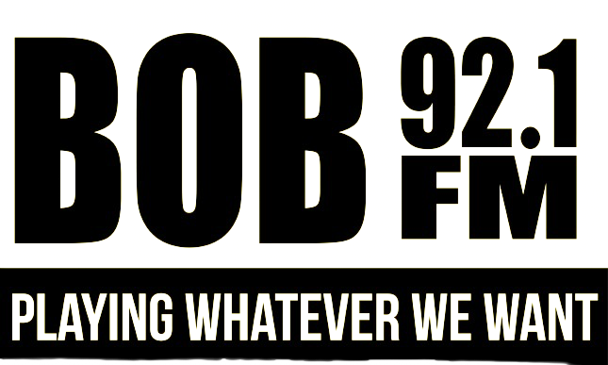
MEDIA KIT
OHANA MEDIA GROUP

Slide 2

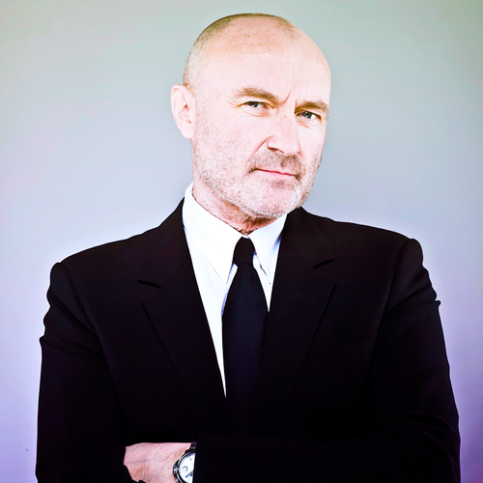
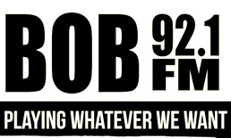
KBBO 92.1 FM
  Bob FM 92.1 is Anchorage's go-to station for a wide variety of hits from multiple eras and genres.
  We pride ourselves on providing a refreshing and unpredictable listening experience for our audience.
  With no DJ interruptions, our playlist keeps listeners engaged with back-to-back hits and surprises.
  Bob FM 92.1 offers a unique advertising opportunity for businesses to reach a diverse audience who appreciates the element of surprise and enjoys a mix of familiar favorites and hidden gems.

Slide 3
KBBO 92.1 FM
Engaging and Influential Personalities:
Our on-air personalities have a strong influence on our audience. They connect with listeners on a personal level, creating a unique bond that extends to the brands they endorse. By partnering with our stations, you can leverage the influence and rapport our personalities have with their dedicated fan base, effectively promoting your products or services.
Five reasons why advertising on Ohana Media Radio Stations in Anchorage Alaska Works
3
Extensive Reach:
Ohana Media Group's radio stations have a wide and loyal listener base, ensuring that your message reaches a large and diverse audience in Anchorage, Alaska. With a variety of formats, we can target specific demographics and cater to different interests, maximizing the potential reach of your advertising campaign.
Targeted Advertising Opportunities:
Ohana Media Group offers targeted advertising opportunities that allow you to reach specific demographics or interest groups. Whether you want to target country music lovers, rock enthusiasts, or the adult contemporary audience, our diverse range of stations ensures that your message is delivered to the right people at the right time, maximizing the effectiveness of your campaign.
1
4
Deep Local Connection:
Ohana Media Group's radio stations have deep-rooted connections within the local community. Anchorage residents trust and rely on our stations for news, entertainment, and music. By advertising on our platforms, you tap into this strong local connection and build brand credibility, fostering trust and loyalty among consumers.
Multi-Channel Approach:
Ohana Media Group's radio stations provide a multi-channel approach to advertising. In addition to on-air commercials, we offer digital advertising options on our social media platforms. This multi-channel approach allows for broader exposure, reaching audiences across different mediums and increasing the chances of reaching your target audience multiple times, reinforcing your brand message.
2
5

Slide 4

KBBO 92.1 FM
TARGET AUDIENCE
25-64
53%
47%
Our target audience ranges from 25-64 yearl old adults
53% of our audience is comprised of male listeners
47% of our audience is comprised of female listeners

Slide 5

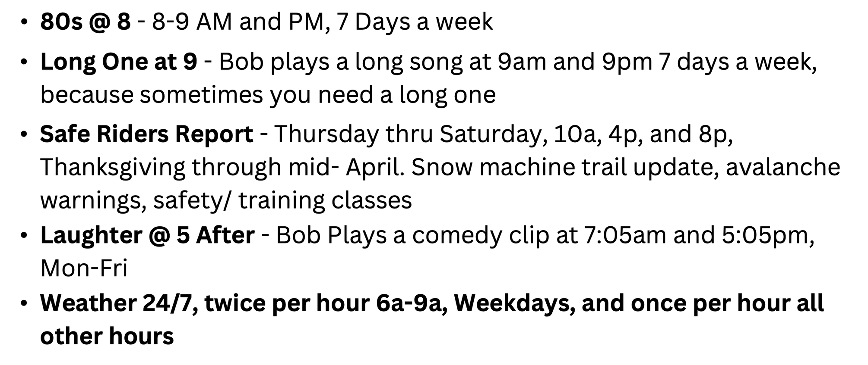
KBBO 92.1 FM FEATURES

