Slide 1

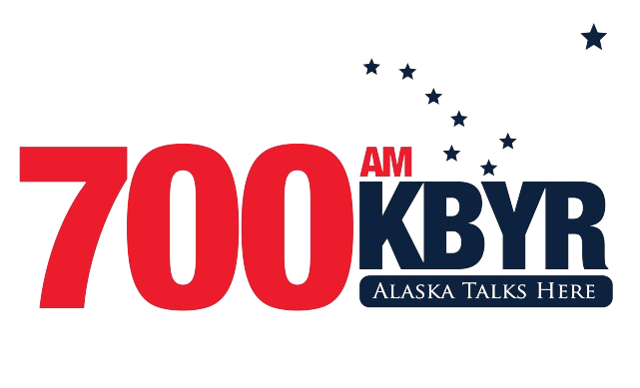
MEDIA KIT
OHANA MEDIA GROUP

Slide 2

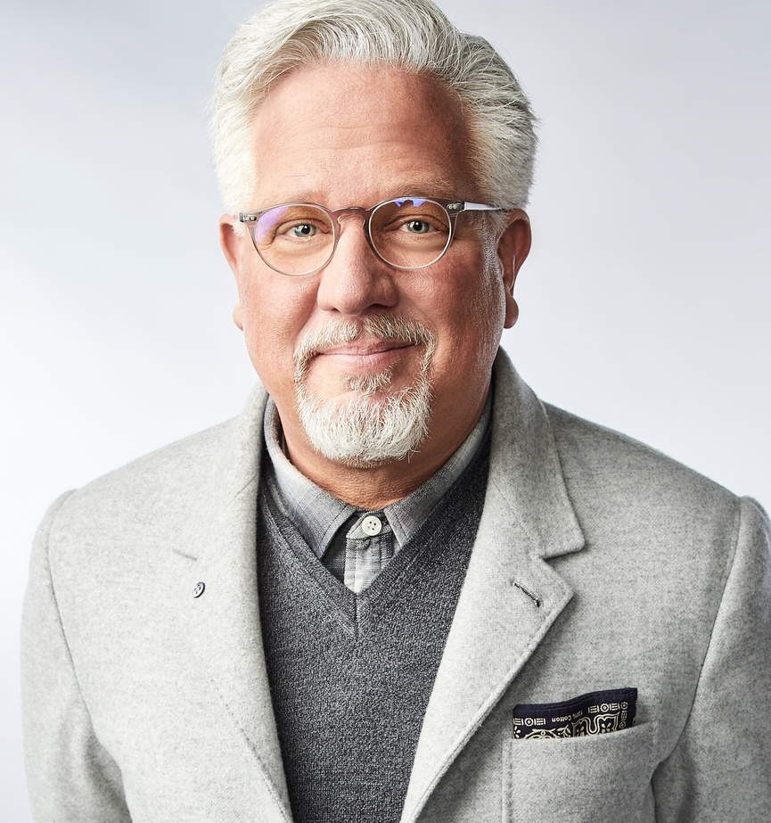
KBYR 700 AM
700 AM KBYR is Anchorage's premier news talk radio station. With an engaging lineup of local and national talk shows, we keep our audience informed and entertained.
From news and politics to lifestyle and community discussions, we cover a wide range of topics that resonate with our listeners.
Our dedicated team of on-air hosts brings a wealth of knowledge and expertise to the airwaves, creating an engaged and receptive audience for advertisers looking to reach informed and influential individuals.

Slide 3
KBYR 700 AM
Engaging and Influential Personalities:
Our on-air personalities have a strong influence on our audience. They connect with listeners on a personal level, creating a unique bond that extends to the brands they endorse. By partnering with our stations, you can leverage the influence and rapport our personalities have with their dedicated fan base, effectively promoting your products or services.
Five reasons why advertising on Ohana Media Radio Stations in Anchorage Alaska Works
3
Extensive Reach:
Ohana Media Group's radio stations have a wide and loyal listener base, ensuring that your message reaches a large and diverse audience in Anchorage, Alaska. With a variety of formats, we can target specific demographics and cater to different interests, maximizing the potential reach of your advertising campaign.
Targeted Advertising Opportunities:
Ohana Media Group offers targeted advertising opportunities that allow you to reach specific demographics or interest groups. Whether you want to target country music lovers, rock enthusiasts, or the adult contemporary audience, our diverse range of stations ensures that your message is delivered to the right people at the right time, maximizing the effectiveness of your campaign.
1
4
Deep Local Connection:
Ohana Media Group's radio stations have deep-rooted connections within the local community. Anchorage residents trust and rely on our stations for news, entertainment, and music. By advertising on our platforms, you tap into this strong local connection and build brand credibility, fostering trust and loyalty among consumers.
Multi-Channel Approach:
Ohana Media Group's radio stations provide a multi-channel approach to advertising. In addition to on-air commercials, we offer digital advertising options on our social media platforms. This multi-channel approach allows for broader exposure, reaching audiences across different mediums and increasing the chances of reaching your target audience multiple times, reinforcing your brand message.
2
5

Slide 4

KBYR 700 AM
TARGET AUDIENCE
45-64
40%
60%
Our target audience ranges from 45-64 yearl old adults
55% of our audience is comprised of female listeners
45% of our audience is comprised on male listners

Slide 5

KBYR 700 AM FEATURES
KBYR 700 AM features weekday lineup of:
5a-8a Glenn Beck
8a-9a Conversation Unlimited
9a-12p The Dana Show
12p-3p Dan Bongino
3p-6p The Joe Pags Show
6p-9p Mark Levin
9p-10p Matt Walsh
10p-11p Ben Shapiro
11p-12M Michael Knowels

