Slide 1

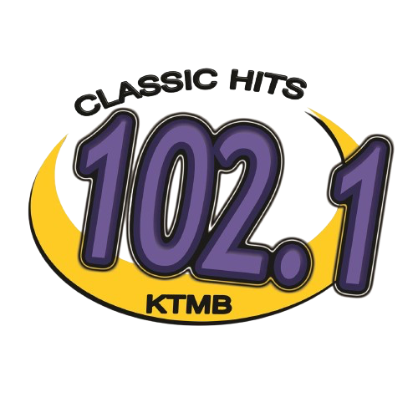
MEDIA KIT
OHANA MEDIA GROUP

Slide 2

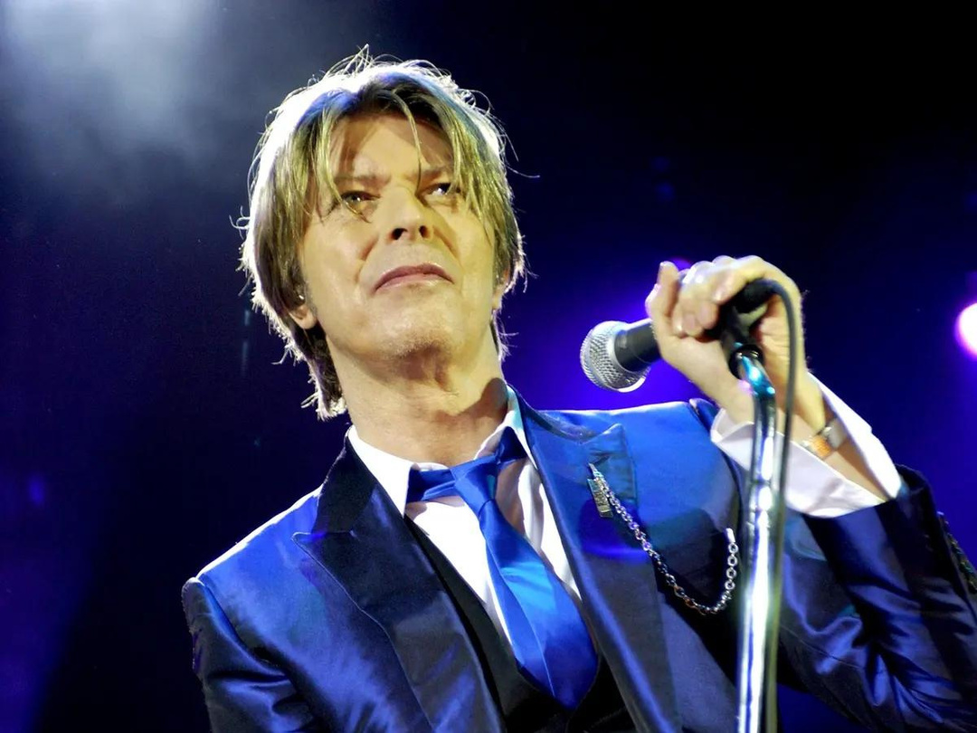
KTMB 102.1 FM
102.1 Classic Hits takes listeners on a nostalgic journey through the greatest hits of all time.
With an iconic playlist spanning multiple decades and genres, we provide an immersive musical experience that resonates with a wide range of listeners.
Our on-air hosts bring the stories behind the hits to life, creating a connection between the music and our audience. 102.1 Classic Hits offers advertisers a platform to reach a diverse audience of music lovers who appreciate the timeless classics.

Slide 3
KTMB 102.1 FM
Engaging and Influential Personalities:
Our on-air personalities have a strong influence on our audience. They connect with listeners on a personal level, creating a unique bond that extends to the brands they endorse. By partnering with our stations, you can leverage the influence and rapport our personalities have with their dedicated fan base, effectively promoting your products or services.
Five reasons why advertising on Ohana Media Radio Stations in Anchorage Alaska Works
3
Extensive Reach:
Ohana Media Group's radio stations have a wide and loyal listener base, ensuring that your message reaches a large and diverse audience in Anchorage, Alaska. With a variety of formats, we can target specific demographics and cater to different interests, maximizing the potential reach of your advertising campaign.
Targeted Advertising Opportunities:
Ohana Media Group offers targeted advertising opportunities that allow you to reach specific demographics or interest groups. Whether you want to target country music lovers, rock enthusiasts, or the adult contemporary audience, our diverse range of stations ensures that your message is delivered to the right people at the right time, maximizing the effectiveness of your campaign.
1
4
Deep Local Connection:
Ohana Media Group's radio stations have deep-rooted connections within the local community. Anchorage residents trust and rely on our stations for news, entertainment, and music. By advertising on our platforms, you tap into this strong local connection and build brand credibility, fostering trust and loyalty among consumers.
Multi-Channel Approach:
Ohana Media Group's radio stations provide a multi-channel approach to advertising. In addition to on-air commercials, we offer digital advertising options on our social media platforms. This multi-channel approach allows for broader exposure, reaching audiences across different mediums and increasing the chances of reaching your target audience multiple times, reinforcing your brand message.
2
5

Slide 4

KTMB 102.1 FM
TARGET AUDIENCE
35-64
50%
50%
Our target audience ranges from 35-64 yearl old adults
50% of our audience is comprised of female listeners
50% of our audience is comprised on male listners

Slide 5

KTMB 102.1 FM FEATURES
The Bob and Sheri Show - 5-9a Mon-Fri. Bob and Sheri is sure to brighten up your day Bob Lacey and Sheri Lynch keep you entertained with a unique take on current events and pop culture. The good, the bad, and the funny!
Super Dave - Alaska Broadcaster’s Association Hall of Fame, Super Dave Stroll, keeps you entertained through the workday, with music tidbits and special quips that’ll make you smile. 9a-3p 6 days a week!
Eddie P - Alaska Broadcaster’s Association Hall of Famer Eddie P, takes you home with his unique personality. A staple in Anchorage radio and tv for 40 years. 3p-7p, 6 days a week, and 3-6 on Sundays!
Back to the 70's - M.G. Kelly takes your listeners back to the 70s in his fast paced, high energy style M.G. recreates that old magic again with an explosion

